Slide 1
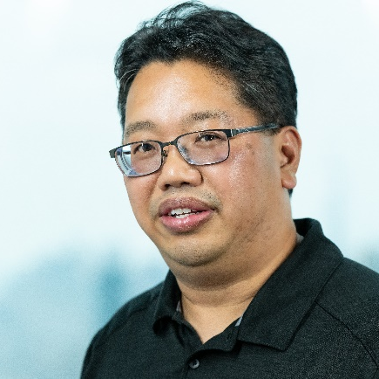
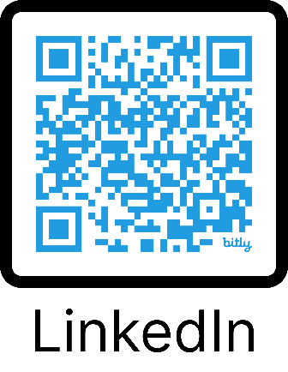
Wagtail Space
Wagtail For Affinity Groups – A Proof Of Concept
Anthony Garcia
June 21, 2024

Slide 2

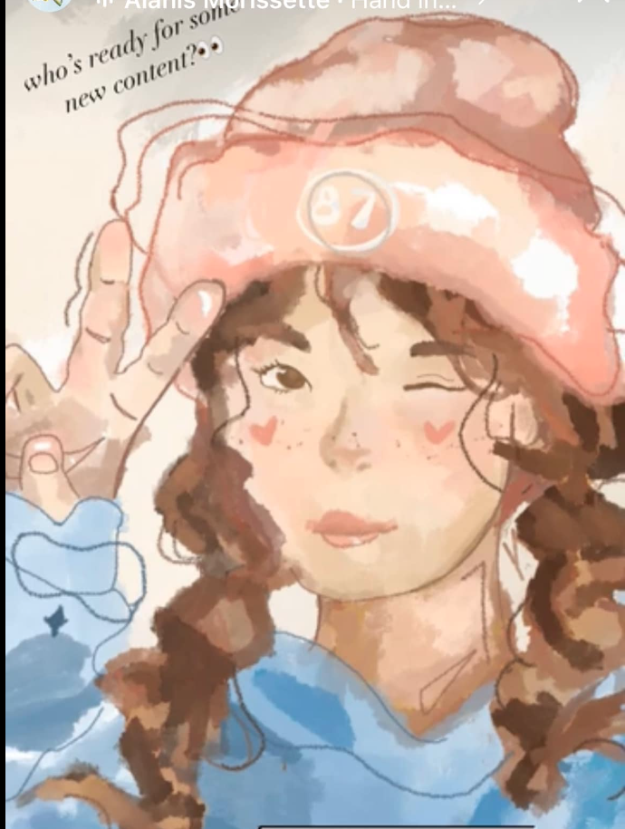
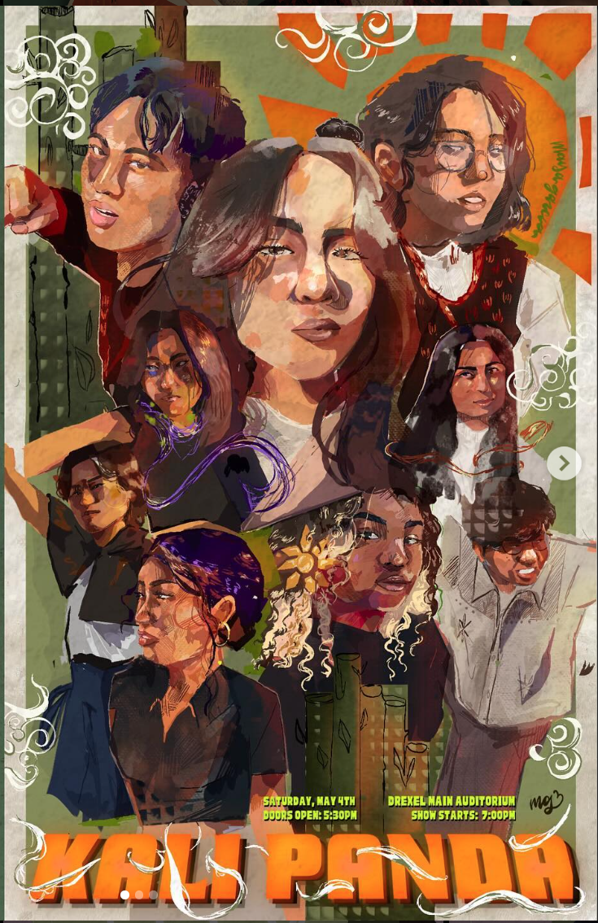
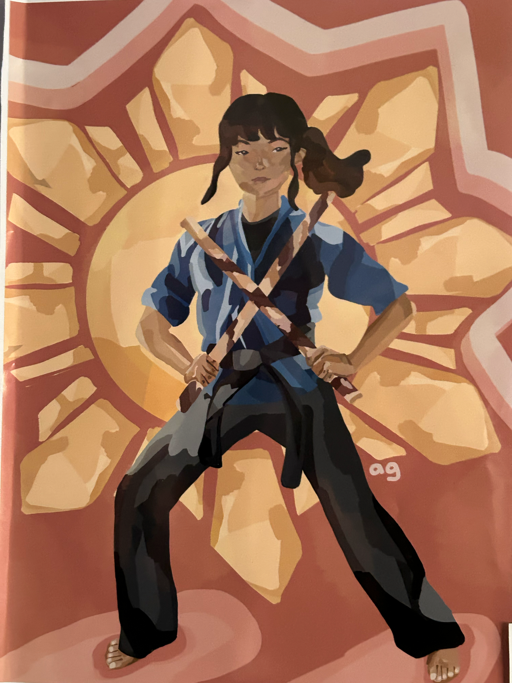
Total Girl Dad - Involved In Many Affinity Groups
Maya - Game Design and Artist
Amy - UI/UX Design and Martial Artist
Local Music Catholic School System Karate Art Community Gardening | Special Olympics Environmental Advisory Toastmasters Foreign Trained Dentists MakerFaire

Slide 3

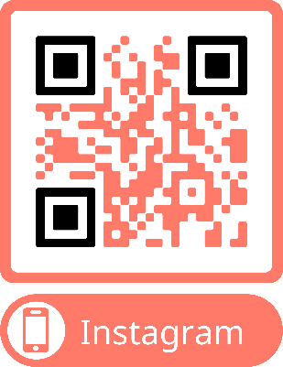

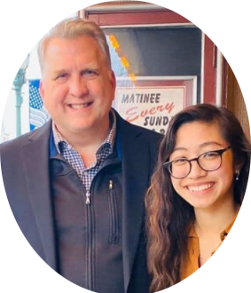
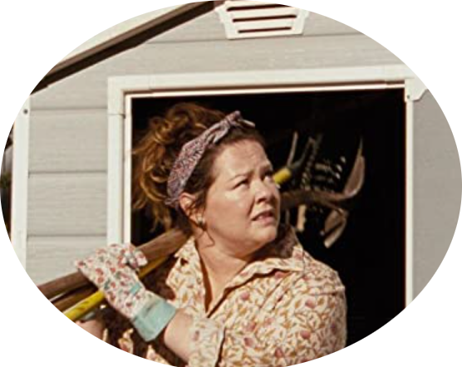



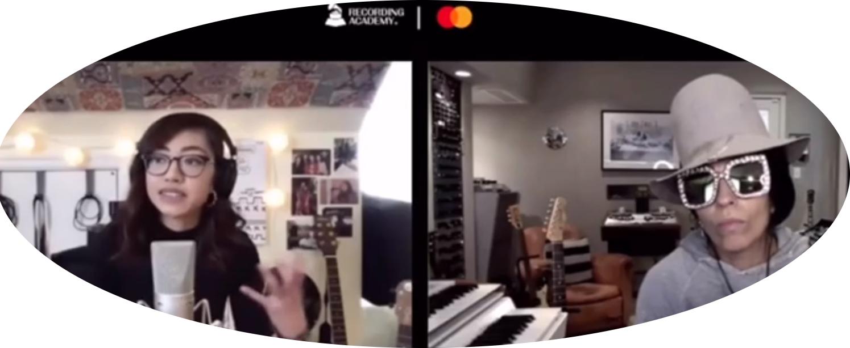







My Origin Story - Start With Why.
Supporting Alyssa’s songwriting journey for 10+ years
Mentorships
Placements
Alyssa Garcia
Performances

Slide 4
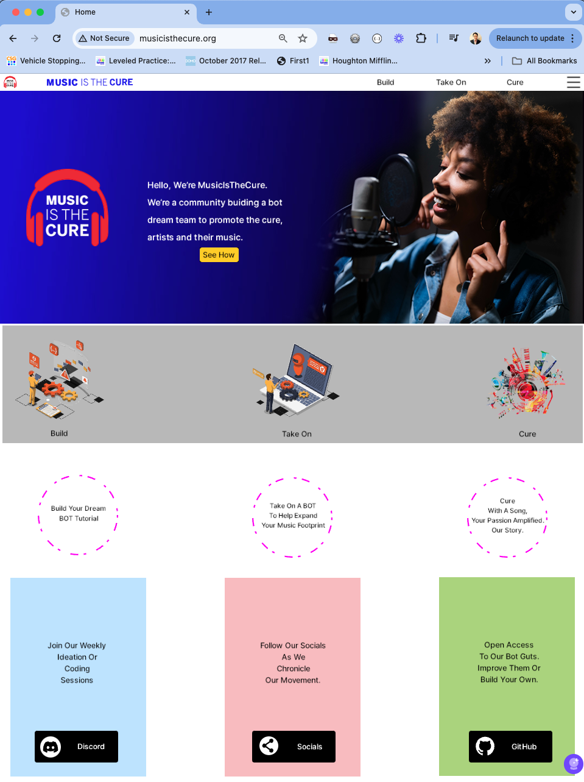
Helping Alyssa.
Alyssa performs locally in Philadelphia and out on the interwebs.
There are many social media tools but maybe we can fashion something more prescriptive for music creators by music creators.

Slide 5
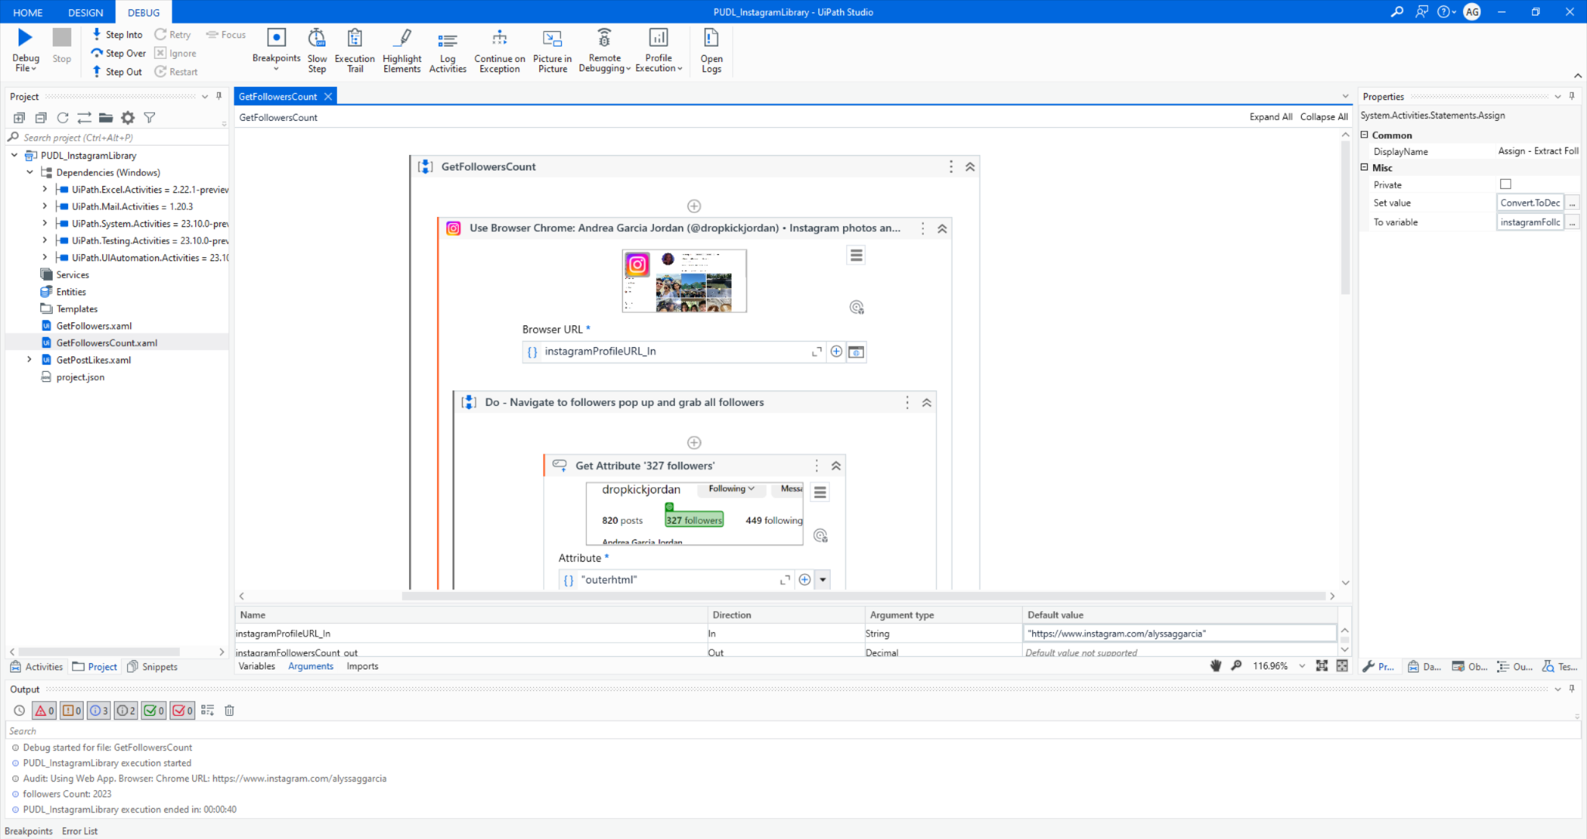
Demonstration
Let’s walk through a demonstration of an Instagram Follower Count Bot.
Notes:
You can do this same bot using your own database, python, and selenium.

Slide 6
Problem Statement & Proposed Solution
Problem
Solution
I aim to extend UiPath to affinity groups, just as it's accessible to corporate groups, to address their shared issue of inefficient manual task completion.
Affinity groups, despite lacking in automation adoption, have the potential to generate automation ideas, realize opportunities, and grow membership. Possible metrics include membership count, # of automation ideas, realized opportunities, and UiPath community growth stemming from these sponsored groups.
The implementation costs could be covered through nominal membership or transaction fees.
The proposition involves a content management system utilizing UiPath bots. Affinity groups could use a website backed by a UiPath automation platform, providing members with a visually engaging dashboard that illustrates bot work. These bots would execute key tasks, generating useful information to support group members' goals.
Current solutions, like Reddit or Instagram, cater to a general audience and lack tailored automations for specific affinity groups' needs. Our solution aims to reveal UiPath's potential to boost citizen development outside corporate environments.
This model has the potential for rapid scalability within a year, and can gradually introduce other UiPath technologies (currently exclusive to corporate clientele), such as the automation hub. The hub could collect automation ideas from group members. A modest, transaction-based model would cover costs, making it affordable for members to employ bots.

Slide 7
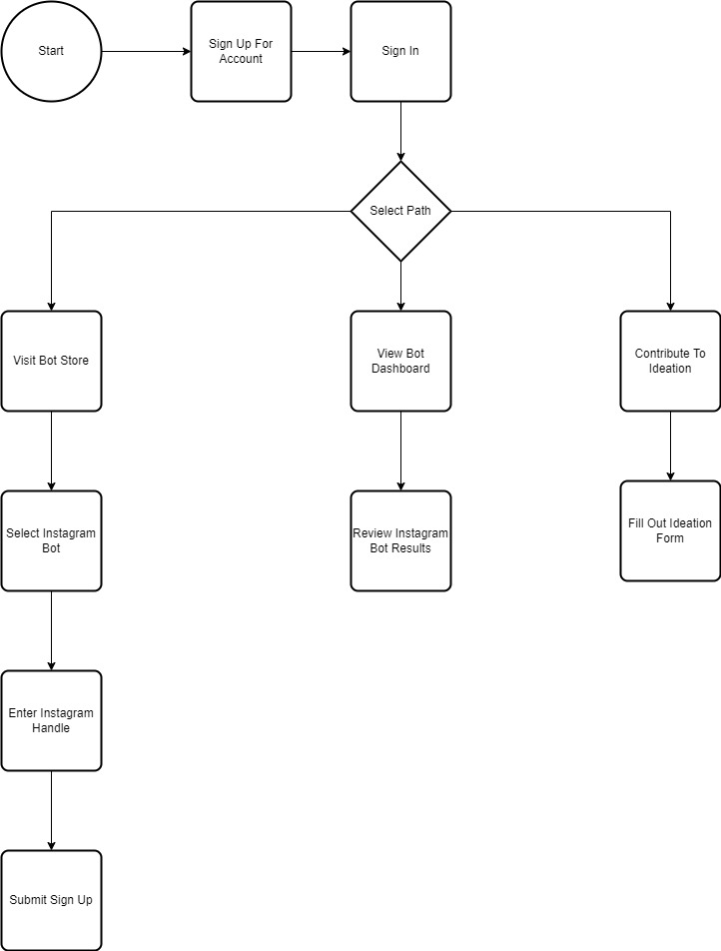
Process Flowchart for Affinity Group Communities With Bot Helpers

Slide 8
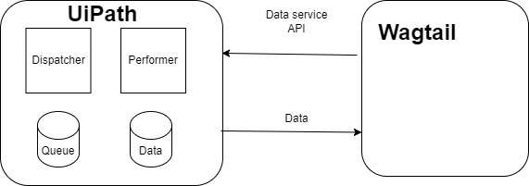
Solution Architecture

Slide 9
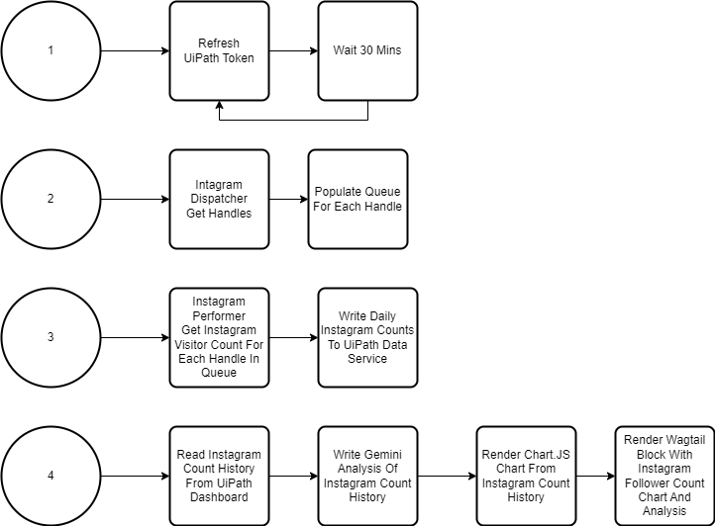
Solution Design for Affinity Group Communities With Bot Helpers

Slide 10
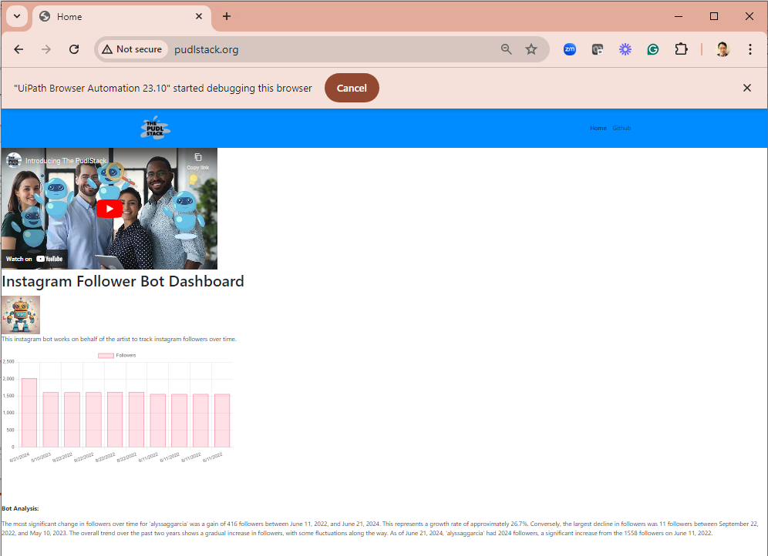
Demonstration
Let’s walk through the Wagtail prototype.
Notes:
You can do this same bot using your own database, python, and selenium.

Slide 11
Benefits & Technologies Used
Details
Benefits
Singer-songwriters can have an army of bots working on their behalf helping them reach the goal of 1000 true fans.
Initially, they can read better into their fan-base by monitoring their socials in a custom way. Eventually, we could have bots literally being their talent agent helping them book gigs, maybe even planning a tour.
Ideation forms can lay out a vision for additional bot helpers.
Citizen developers can learn low code methods to build bots anchored in a wagtail based community site.
End-User | Independent Singer-Songwriter
User Department | Independent
UiPath Products Used | UiPath Community Edition
Other – Integrations / APIs / Technologies Used | Python/Django/Wagtail, Charts.JS, Bootstrap, Google Gemini API, Linux

Slide 12
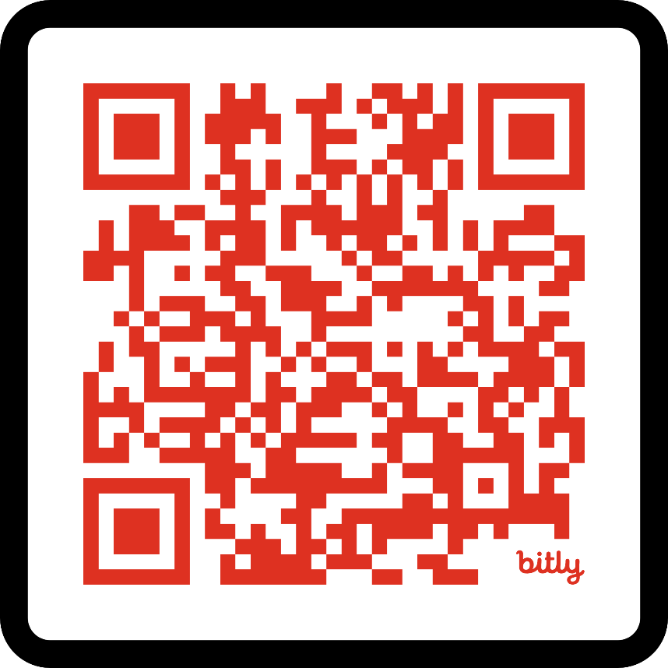
Questions?
Presentation And Code
https://github.com/pudlstack
Notes:
Visit pudlstack.org for a demo video and visit periodically as the website evolves.
Resources –
Learning Wagtail and Python - Thanks Kalob Taulien
LearnWagtail.Com
https://www.udemy.com/course/the-ultimate-fullstack-web-development-bootcamp
Wagtail Slack – Thanks Tim Allen, Torchbox, Wagtail Core Team – Special shout out to Cynthia Kiser, Scott Cranfill, Vince Salvino
https://wagtailcms.slack.com/
UiPath Academy
https://academy.uipath.com/
https://community.uipath.com/

